Slide 1
Machine Learning for NLP
NLP II 2025 Attapol Thamrongrattanarit รศ. ดร.อรรถพล ธำรงรัตนฤทธิ์

Slide 2
Technology
Automatic text processing
Collect the data from various platforms
Word segmentation, text cleaning, and normalization
Machine Learning
The intelligent algorithm of NLP

Slide 3
Machine Learning Techniques in NLP
Supervised Learning
Unsupervised Learning
Transfer Learning

Slide 4
Machine Learning Techniques in NLP
Supervised Learning
Unsupervised Learning
Transfer Learning

Slide 5
Supervised ML algorithm is a process of learning the relationship between input and output (label).

Slide 6
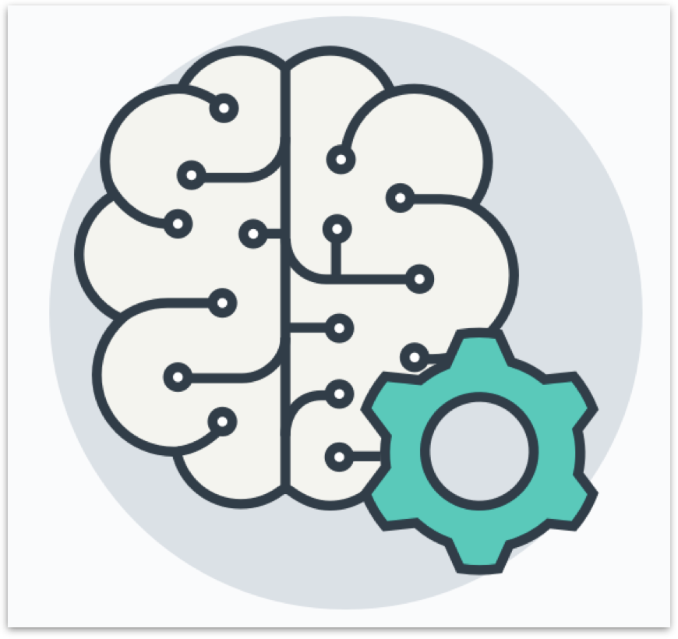
Supervised ML algorithms learn from examples
Training data
Machine Learning Algorithm
Input | Output

Slide 7
Training data
Machine Learning Algorithm
Input | Output
"สวัสดีครับ" | สวัสดี | ครับ
"ถามหน่อยครับ" | ถาม | หน่อย | ครับ
 | ...
"ขอโทษค่ะ อะไรนะคะ" | ขอโทษ | ค่ะ | อะไร | นะ | คะ
'Training' a word segmenter

Slide 8
Training data
Input | Output
"อาหารเหมาะสำหรับสัตว์เลี้ยงเท่านั้น" | 😣
"ไกลแค่ไหนก็ต้องมาทาน" | 😀
... | ...
"พนักงานบริการเต็มใจมาก" | 😣
Machine Learning Algorithm
'Training' a sentiment analyzer

Slide 9
To train a model =
To make the machine learn from the data

Slide 10
Machine Learning Techniques in NLP
Supervised Learning
Unsupervised Learning
Transfer Learning

Slide 11
Unsupervised ML algorithm is a process of learning the patterns in the input such as natural grouping

Slide 12
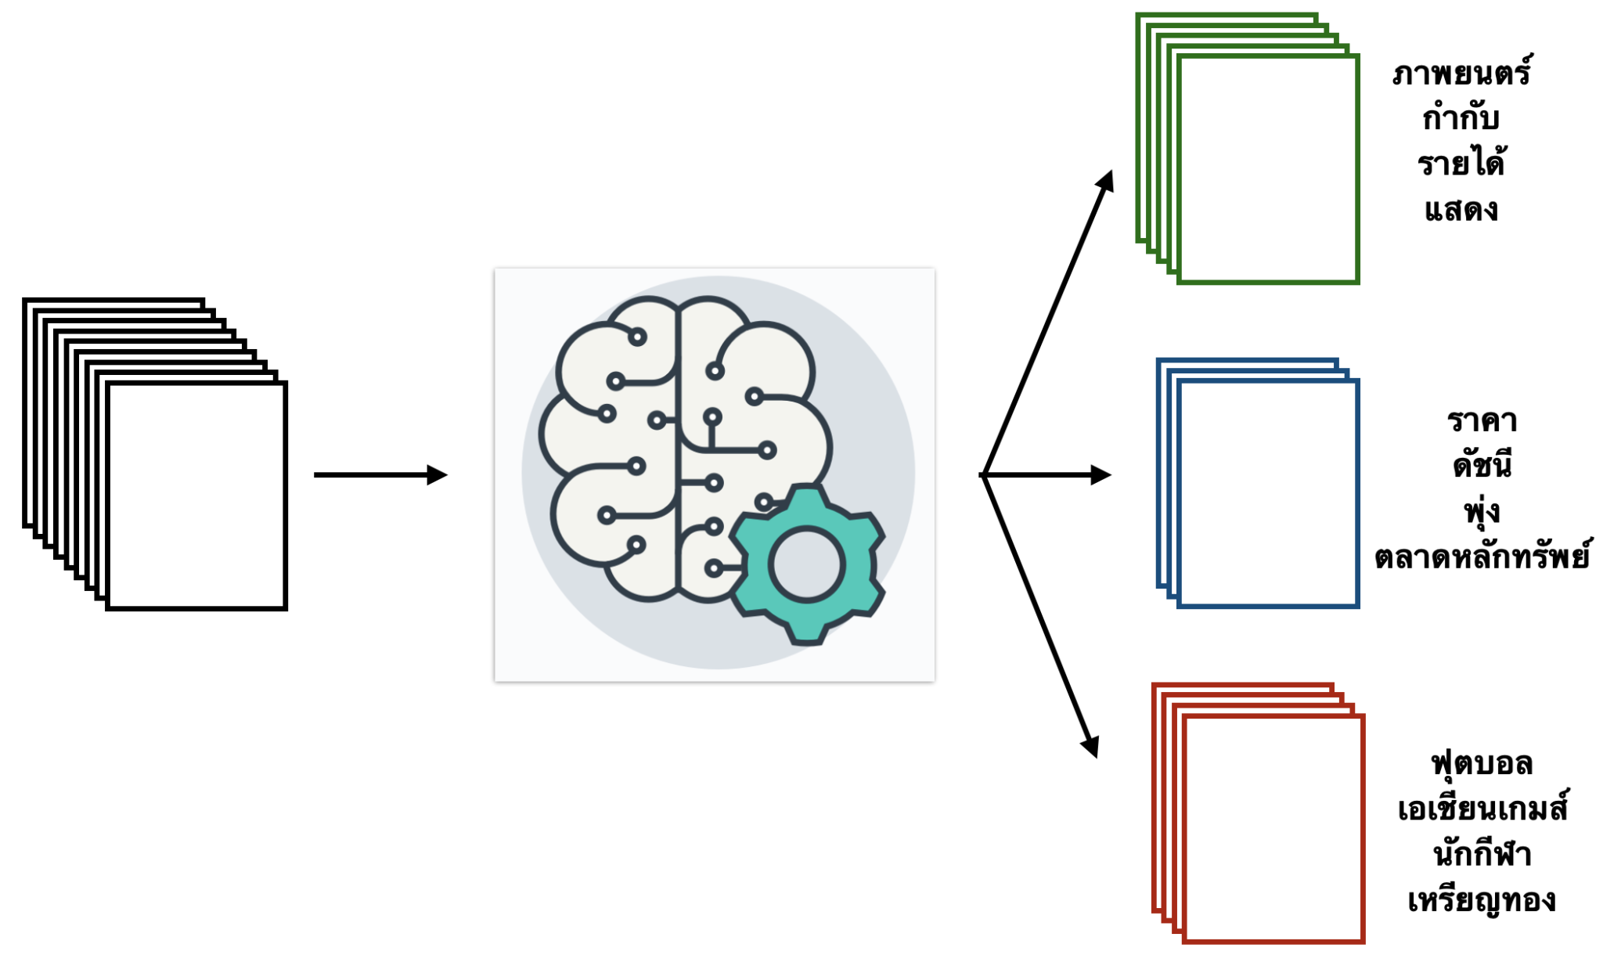

Slide 13
couch
office
furniture
bench
director
couch
head
sofa
executive
armchair
staff
table
president
Clustering words can reveal senses of words.

Slide 14
"Money printing and weak currencies make things more expensive in financially weak nations."
Low-income nations often see rising expenses due to problems with supply and demand.
Why do prices rise in poor countries?
Prices rise in all poor countries
High debt and bad government policies cause price increases in poorer economies.
An unsupervised ML model group the query with the 'right' documents

Slide 15
Machine Learning Techniques in NLP
Supervised Learning
Unsupervised Learning
Transfer Learning

Slide 16
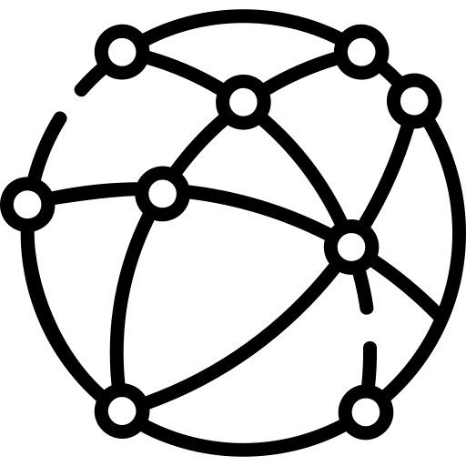

Training data
Input | Output
"อาหารเหมาะสำหรับสัตว์เลี้ยงเท่านั้น" | 😣
"ไกลแค่ไหนก็ต้องมาทาน" | 😀
... | ...
"พนักงานบริการเต็มใจมาก" | 😣
Learning the language from 50GB+ of text data from the internet (Pretraining process)
Learning the task from the training data
(Fine-tuning process)

Slide 17
Text Classification
NLP II 2025 Attapol Thamrongrattanarit รศ. ดร.อรรถพล ธำรงรัตนฤทธิ์

Slide 18
Text Classification
Text classification is the task of assigning predefined categories or labels (output) to a given piece of text (input), which can be a sentence, a document, or a set of documents.

Slide 19
😣
Text input
"อาหารเหมาะสำหรับสัตว์เลี้ยงเท่านั้น"
"ไกลแค่ไหนก็ต้องมาทาน"
...
"พนักงานบริการเต็มใจมาก"
😀
😐
Predefined categories or labels
Sentiment Analysis

Slide 20


OK
Text input
"ชื่นชอบผลงานมานานแล้วค่ะ"
"เงินกู้ด่วน ไม่ต้องค้ำ ดอกเบี้ยต่ำ คลิกเลย"
"ถ้าจะเต้นแค่นี้ กลับบ้านเหอะ เซ็ง"
...
"เพลงน่าจะชัดกว่านี้ค่ะ แต่เต้นเป๊ะมาก"
Predefined categories or labels
Spam classification

Slide 21
บุญคุณต้องทดแทน
word boundary
บุญคุณ|ต้อง|ทดแทน
non-word boundary
Predefined categories or labels
Word segmentation result

Slide 22
บุญคุณต้องทดแทน
บุญคุณต้องทดแทน
word boundary
word boundary
non-word boundary
non-word boundary
Predefined categories or labels
Predefined categories or labels
Word segmentation

Slide 23
Other examples
Automatic Essay Grading
Input: essay text
Output: {A, B, C, D}
Language Identification
Input: text
Output: {FR, EN, TH, ZH, …}
Fake news detection
Input: news text
Output: fake or not-fake
Intent classification
Input: utterance
Output: {apology, request, complaint, … }

Slide 24
Types of Classifiers
Rule-based classifier
ML-based classifier

Slide 25
Rule-based classifier
A classifier that relies on a set of predefined rules to assign labels to text such as keywords, regular expressions, and lexicons.
A lexicon (or dictionary or word list) is a collection of words and/or phrases optionally along with their meanings or attributes.

Slide 26
Spam Classifier - keyword-based classifier
def spam_classify(text):
keywords = {'viagra', 'lottery', 'free money'}
for word in text:
if word in key_words:
return 'SPAM'
return 'NOT SPAM'

Slide 27
Email classifier -- regex-based
def email_classify(token):
pattern = re.compile('^[a-zA-Z0-9._%+-]+@[a-zA-Z0-9.-]+\.[a-zA-Z]{2,}$')
return pattern.match(token)

Slide 28
Name recognition - Lexicon-based
def recognize_name(token):
# Where do we get the list of names from?
name_list = read_lexicon_from_file('my_name_lexicon.txt')
if token in name_list:
return 'NAME'
return 'NOT NAME'

Slide 29
Discuss with your neighbor
Write a rule-based classifier for detecting English vs French vs Spanish
Write a rule-based classifier for recognizing typically Thai male name vs typically Thai female name

Slide 30
What are the pros and cons of rule-based classifiers?

Slide 31
Pros and cons of rule-based classifier
Pros
Simplicity
Transparency
Scalability
Cons
Limited performance
Sensitive to noise
Labor intensive

Slide 32
Types of Classifiers
Rule-based classifier
ML-based classifier

Slide 33
ML-based classifier
An ML-based classifier rely on supervised learning methods that learn from labeled text data to classify new unseen text data.
Popular ML models
Naive Bayes
Logistic Regression
Deep learning models

Slide 34
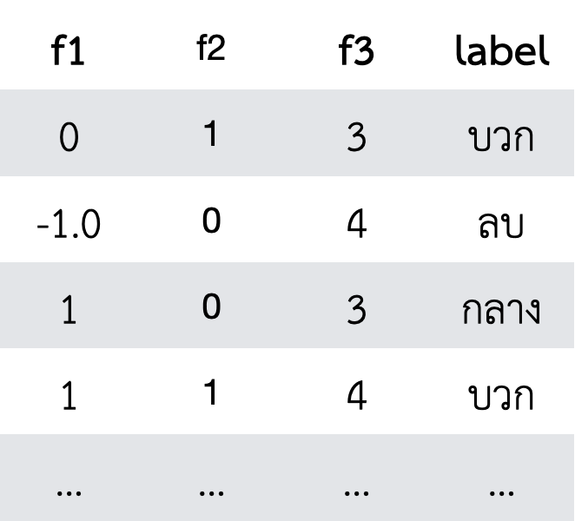
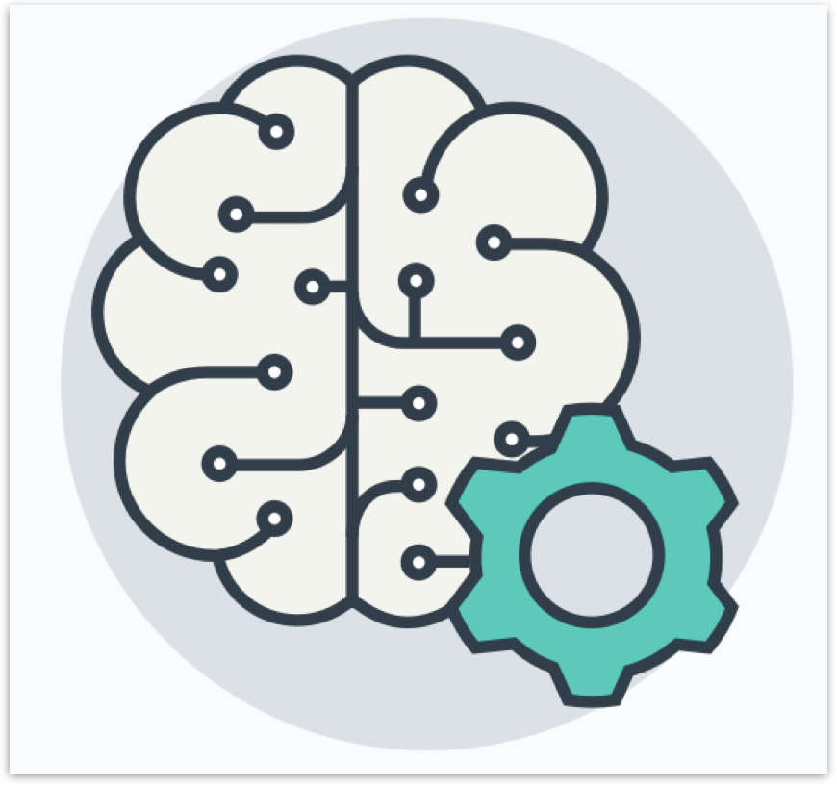

4 Steps for Supervised Learning
Input | Output
"อาหารเหมาะสำหรับสัตว์เลี้ยงเท่านั้น" | 😣
"ไกลแค่ไหนก็ต้องมาทาน" | 😀
... | ...
"พนักงานบริการเต็มใจมาก" | 😣
Data preparation | Feature engineering | Model training | Evaluation

Slide 35


1. Data Preparation
😣
Text input
"อาหารเหมาะสำหรับสัตว์เลี้ยงเท่านั้น"
"ไกลแค่ไหนก็ต้องมาทาน"
...
"พนักงานบริการเต็มใจมาก"
😀
😐
Choosing data sources | Defining instances | Defining labels

Slide 36
Data Annotation
Input | Output
"อาหารเหมาะสำหรับสัตว์เลี้ยงเท่านั้น" | 😣
"ไกลแค่ไหนก็ต้องมาทาน" | 😀
... | ...
"พนักงานบริการเต็มใจมาก" | 😣
Data needs to be labeled (annotated) by humans. This process is often costly and slow.

Slide 37
4 Steps for Supervised Learning
Input | Output
"อาหารเหมาะสำหรับสัตว์เลี้ยงเท่านั้น" | 😣
"ไกลแค่ไหนก็ต้องมาทาน" | 😀
... | ...
"พนักงานบริการเต็มใจมาก" | 😣
Data preparation | Feature engineering | Model training | Evaluation

Slide 38
Feature Engineering
Extracting relevant features (numbers or signal) from the text data that are indicative of the label.

Slide 39
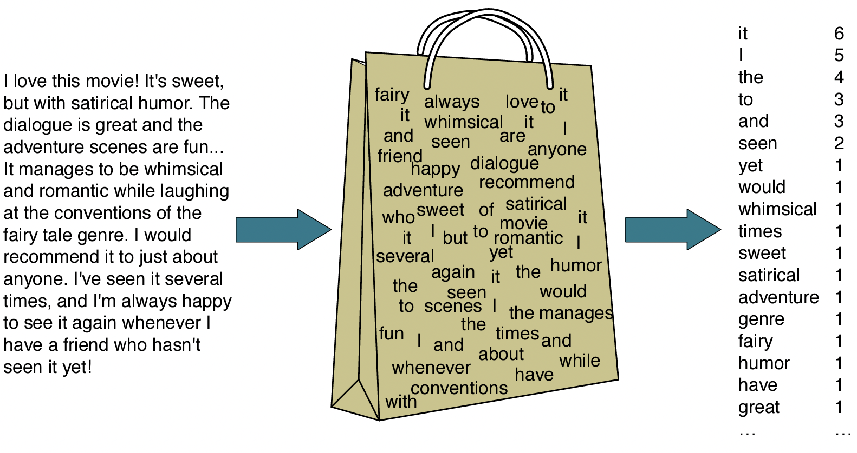
Bag-of-word features
Taken from Martin and Jurafsky 3rd ed.

Slide 40
4 Steps for Supervised Learning
Input | Output
"อาหารเหมาะสำหรับสัตว์เลี้ยงเท่านั้น" | 😣
"ไกลแค่ไหนก็ต้องมาทาน" | 😀
... | ...
"พนักงานบริการเต็มใจมาก" | 😣
Data preparation | Feature engineering | Model training | Evaluation

Slide 41
Model Training
Feeding the training data to the model for the model to learn the relationship between features and labels.

Slide 42
Train-validation-test data split
The data must first be split into three subsets:
Training set -- for training models
Validation set (holdout set or development set) -- for iteratively evaluating models
Test set -- for final evaluation of the model

Slide 43
For example,
60:20:20 Split
idx | Date | Text | Label
1 | 31 Dec 2019 | xxx | yy
2 | 1 Jan 2020 | xxx | yy
3 | 4 Jan 2020 | xxx | yy
4 | 7 Jan 2020 | xxx | yy
5 | 8 Jan 2020 | xxx | yy
6 | 8 Jan 2020 | xxx | yy
7 | 9 Jan 2020 | xxx | yy
8 | 9 Jan 2020 | xxx | yy
9 | 9 Jan 2020 | xxx | yy
10 | 11 Jan 2020 | xxx | yy
Training set
Validation set
Test set

Slide 44
Bias in data preparation
If the data is ordered (e.g., by time or some natural sequence), then splitting without shuffling might result in the training set containing only older data and the test set containing newer data.

Slide 45
For example,
60:20:20 Split
idx | Date | Text | Label
1 | 31 Dec 2019 | xxx | yy
2 | 1 Jan 2020 | xxx | yy
3 | 4 Jan 2020 | xxx | yy
4 | 7 Jan 2020 | xxx | yy
5 | 8 Jan 2020 | xxx | yy
6 | 8 Jan 2020 | xxx | yy
7 | 9 Jan 2020 | xxx | yy
8 | 9 Jan 2020 | xxx | yy
9 | 9 Jan 2020 | xxx | yy
10 | 11 Jan 2020 | xxx | yy
Training set
Validation set
Test set

Slide 46
Shuffled
idx | Date | Text | Label
4 | 7 Jan 2020 | xxx | yy
7 | 9 Jan 2020 | xxx | yy
1 | 31 Dec 2019 | xxx | yy
10 | 11 Jan 2020 | xxx | yy
5 | 8 Jan 2020 | xxx | yy
2 | 1 Jan 2020 | xxx | yy
6 | 8 Jan 2020 | xxx | yy
9 | 9 Jan 2020 | xxx | yy
8 | 9 Jan 2020 | xxx | yy
3 | 4 Jan 2020 | xxx | yy
Training set
Validation set
Test set

Slide 47
Deduplication
Deduplication is removal of identical or nearly identical examples that appear multiple times within the same dataset or across different splits
Why?
Duplicates can give the false impression of having more diverse data than is actually present.
Duplicates in the dev/test sets can bias performance metrics because the model is essentially being tested on the same input multiple times.

Slide 48
Model training
We train the model on the training set. Each model has its own formula for training the model parameters.
We evaluate the model on the dev set. Each model has its own way of using the trained parameters. This process is called 'inference' (the model infers the labels from the text)

Slide 49
Naive Bayes Model

Slide 50
Naive Bayes Classifier
A model that uses Bayesian inference from probability theory to infer the label given the text input. This model is outdated now, but it is the simplest ML model, which performs decently well.

Slide 51
Bayesian Inference
Positive or negative? : 'predictable but very fun'
Let Y = label, X = text data
P(Y=positive | X= 'predictable but very fun') ถ้า text = 'predictable but very fun' แล้วมีความน่าจะเป็นเท่าไรที่ label จะเป็น positive
P(Y=negative | X= 'predictable but very fun') ถ้า text = 'predictable but very fun' แล้วมีความน่าจะเป็นเท่าไรที่ label จะเป็น negative

Slide 52
Bayesian Inference (2)
P(Y=positive | X= 'predictable with no fun')
= P(X= 'predictable but very fun'| Y=positive) P(Y=positive) P(X= 'predictable but very fun'| Y=positive) P(Y=positive) + P(X= 'predictable but very fun'| Y=negative) P(Y=negative)
P(X= 'predictable but very fun'| Y=positive) is called likelihood of the data. If you know that the label is positive, what is the probability of seeing 'predictable with no fun'
P(Y=positive) is called prior probability of the label. If we don't know the text at all, what's the probability of positive label?

Slide 53
Bayesian Inference (3)
P(Y=positive | X= 'predictable with no fun')
= P(X= 'predictable but veryfun'| Y=positive) P(Y=positive) P(X= 'predictable but veryfun'| Y=positive) P(Y=positive) + P(X= 'predictable but very fun'| Y=negative) P(Y=negative)
P(Y=negative | X= 'predictable with no fun')
= P(X= 'predictable but very fun'| Y=negative) P(Y=negative) P(X= 'predictable but very fun'| Y=positive) P(Y=positive) + P(X= 'predictable but very fun'| Y=negative) P(Y=negative)

Slide 54
Bayesian Inference (3)
P(Y=positive | X= 'predictable with no fun')
= P(X= 'predictable but very fun'| Y=positive) P(Y=positive) / Z
P(Y=negative | X= 'predictable with no fun')
= P(X= 'predictable but very fun'| Y=positive) P(Y=negative) / Z

Slide 55
Bayesian Inference (3)
P(Y=positive | X= 'predictable with no fun')
= P(X= 'predictable but very fun'| Y=positive) P(Y=positive) / Z
= P('predictable'|Y=positive) P('but'|Y=positive) P('very'|Y=positive) P('fun'|Y=positive) P(Y=positive) / Z
P(Y=negative | X= 'predictable with no fun')
= P(X= 'predictable but very fun'| Y=negative) P(Y=negative) / Z
= P('predictable'|Y=negative) P('but'|Y=negative) P('very'|Y=negative) P('fun'|Y=negative) P(Y=negative) / Z

Slide 56
Worked Example
Text | Label
predictable and boring | negative
very few laughs | negative
short but boring | negative
very powerful | positive
fun and good laughs | positive
predictable but very fun and powerful | ?
What's the probability of +?
What's the probability of seeing "predictable" in a + document?
What's the probability of seeing "but" in a + document?
https://docs.google.com/spreadsheets/d/1CmbXyFQmu5t1dxxjMek0sxf7pBb1H6WPYjsazO6vQ_E/edit?usp=sharing

Slide 57
Model Parameter
Model parameters are the numbers that the model uses to make prediction.
Model parameters are learned from the data.

Slide 58
Prior probability
Text | Label
predictable and boring | negative
very few laughs | negative
short but boring | negative
very powerful | positive
fun and good laughs | positive
predictable but very fun and powerful | ?
What's the probability of positive?
= #doc + / #docs = 3/5

Slide 59
Likelihood
Text | Label
predictable and boring | negative
very few laughs | negative
short but boring | negative
very powerful | positive
fun and good laughs | positive
predictable but very fun and powerful | ?
What's the probability of seeing "predictable" in a + document? P('predictable'|Y=positive)
= #'predictable' in positive document #words in positive document

Slide 60
Smoothing +1
Text | Label
predictable and boring | negative
very few laughs | negative
short but boring | negative
very powerful | positive
fun and good laughs | positive
predictable but very fun and powerful | ?
What's the probability of seeing "predictable" in a + document?
= #'predictable' in positive document + 1 #words in positive document + vocab size

Slide 61
Pros and cons of ML-based classifier
Pros
High accuracy when a good amount of data is available
Robustness to noise
Learning very complex relationships with a lot of features
Cons
Require datasets which cost time and money to make

Slide 62
4 Steps for Supervised Learning
Input | Output
"อาหารเหมาะสำหรับสัตว์เลี้ยงเท่านั้น" | 😣
"ไกลแค่ไหนก็ต้องมาทาน" | 😀
... | ...
"พนักงานบริการเต็มใจมาก" | 😣
Data preparation | Feature engineering | Model training | Evaluation

Slide 63
Example - Spam classification
OK
Text input
"ชื่นชอบผลงานมานานแล้วค่ะ"
"เงินกู้ด่วน ไม่ต้องค้ำ ดอกเบี้ยต่ำ คลิกเลย"
"ถ้าจะเต้นแค่นี้ กลับบ้านเหอะ เซ็ง"
...
"เพลงน่าจะชัดกว่านี้ค่ะ แต่เต้นเป๊ะมาก"
Ad
Junk

Slide 64
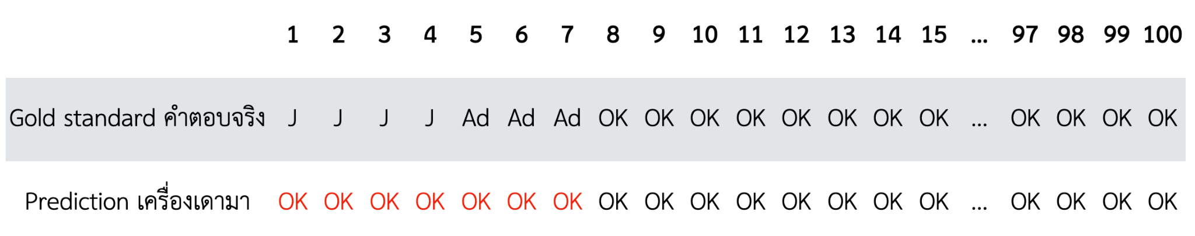
Prediction on dev set

Slide 65
Accuracy
Accuracy = 93 / 100

Slide 66
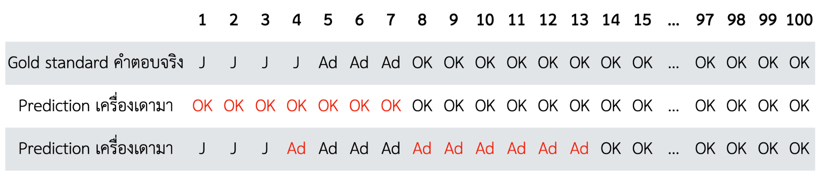
Now compute the accuracy of System A and B
Accuracy of System A = 93 / 100
Accuracy of System B = 93 / 100

Slide 67
Precision and Recall
Precision of label A: If classifier predicts 'A', can we trust it's actually A?
# A correctly predicted / # predicted A
Recall of label A: How many 'A' are actually detected?
# A correctly predicted / # true A

Slide 68
 | Precision | Recall
OK email | 93/100 | 93/93
Junk Mail (J) | NA | 0/4
Advertisement (Ad) | NA | 0/3

Slide 69
F1 score
Precision and recall are calculated for each label. F1 score is the geometric mean of Precision (P) and Recall (R)
F1 of class A = 2PR / (P+R)

Slide 70
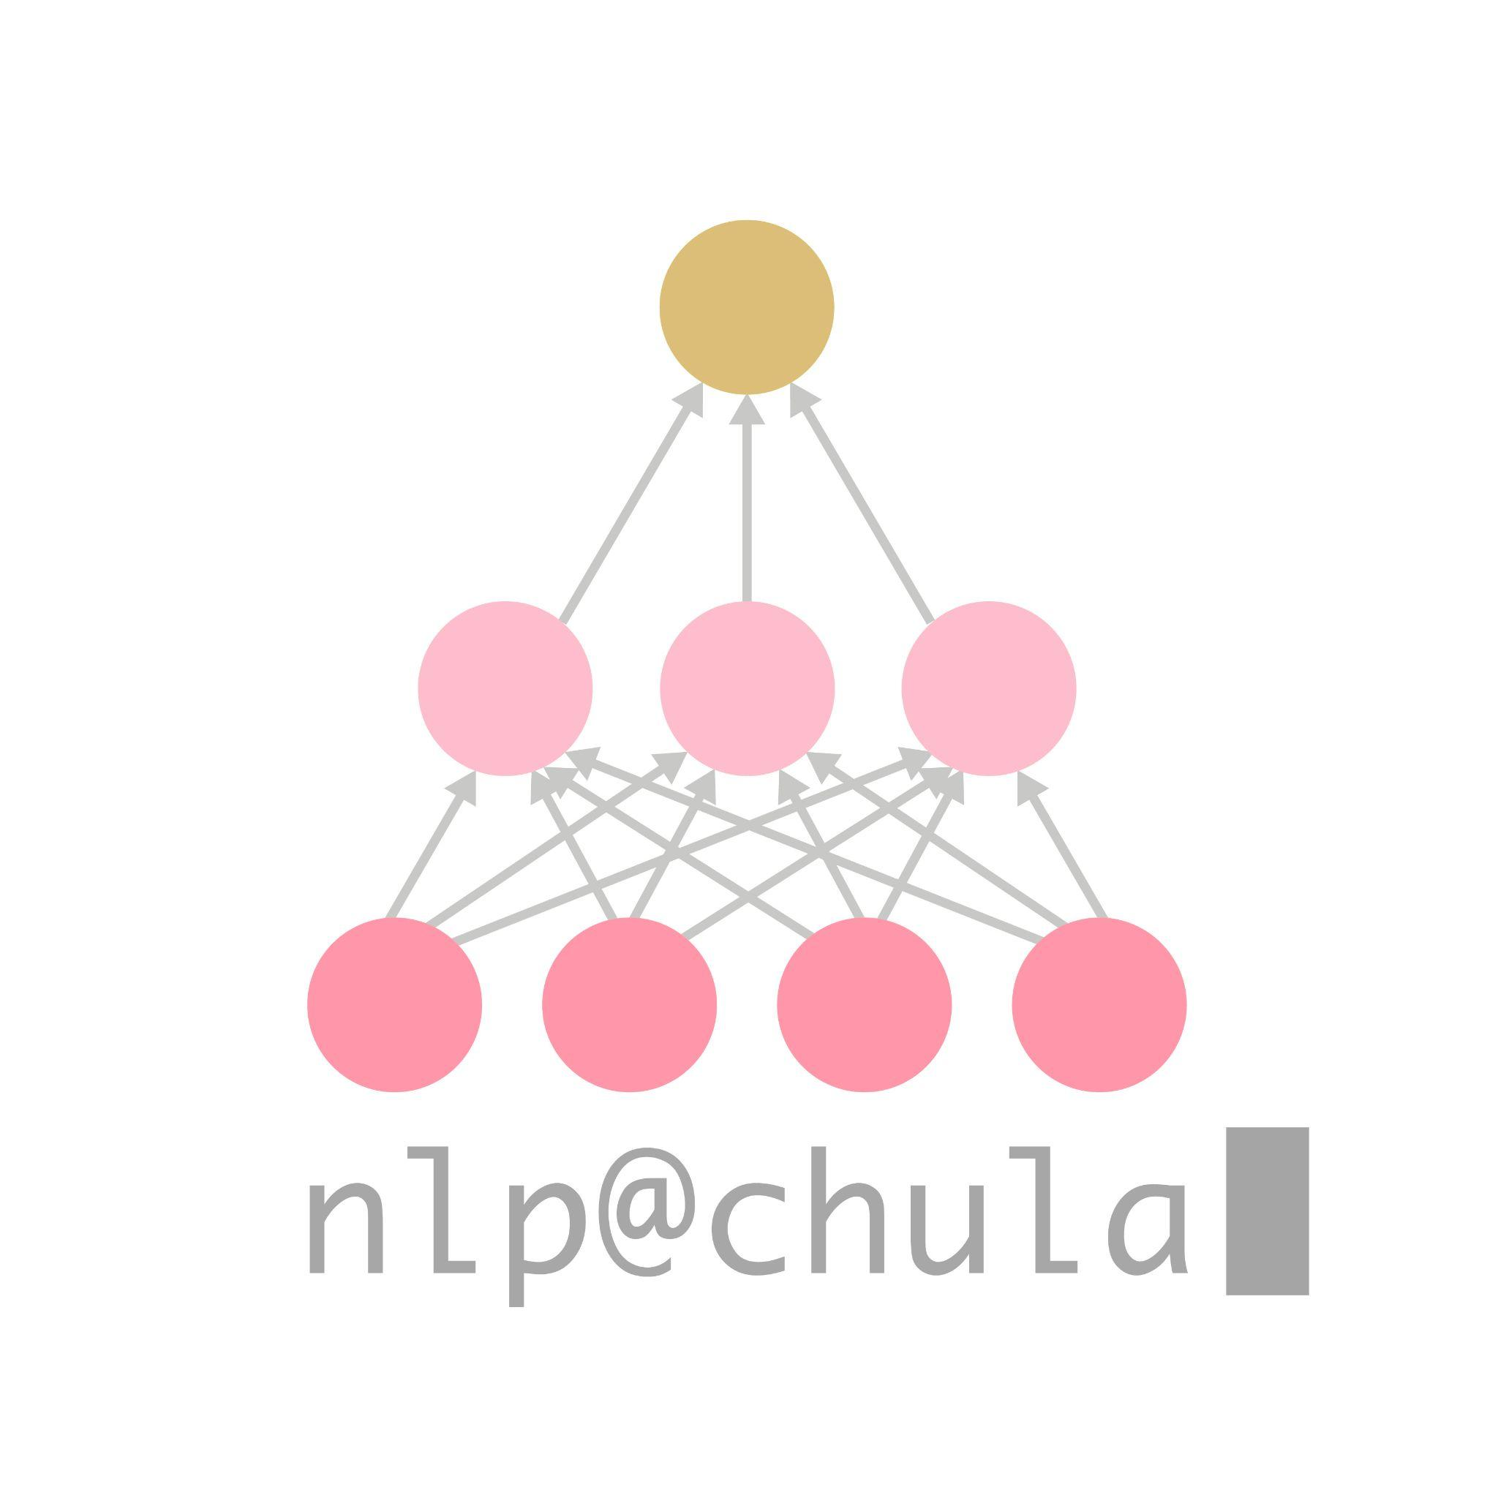
F1 of class OK = 2PR / (P+R)
= 2 * (0.93)* (1.0) / (0.93 + 1.0)
 | Precision | Recall | F1
OK email | 0.93 | 1.0 | 0.96
Junk Mail (J) | NA | 0/4 | 0
Advertisement (Ad) | NA | 0/3 | 0

Slide 71
 |  | Precision |  | Recall | F1
OK email | 86/86 | 1.0 | 86/93 | 0.9247 | 0.9609
Junk Mail (J) | 3/3 | 1.0 | 3/4 | 0.75 | 0.8571
Advertisement (Ad) | 3/10 | 0.3 | 3/3 | 1 | 0.4615

Slide 72
System A
System B
 | Precision | Recall | F1
OK email | 0.93 | 1.0 | 0.96
Junk Mail (J) | NA | 0/4 | 0
Advertisement (Ad) | NA | 0/3 | 0
 | Precision | Recall | F1
OK email | 1.0 | 0.9247 | 0.9609
Junk Mail (J) | 1.0 | 0.75 | 0.8571
Advertisement (Ad) | 0.3 | 1 | 0.4615

Slide 73
Precision and Recall
Precision of label A: If classifier predicts 'A', can we trust it's actually A?
We want high precision when we want to really trust the system.
Recall of label A: How many 'A' are actually detected?
We want high recall when we do not want to miss that label.

Slide 74
Macro-average precision, recall, and F1
 | Precision | Recall | F1
OK email | 1.0 | 0.9247 | 0.9609
Junk Mail (J) | 1.0 | 0.75 | 0.8571
Advertisement (Ad) | 0.3 | 1 | 0.4615
Macro-average | 0.76 | 0.89 | 0.75

Slide 75
Confusion Matrix

Slide 76
 |  | Actual (ความเป็นจริง)
 |  | Junk | Ad | OK
Predicted (เครื่องบอกมา) | Junk | 3 | 0 | 0
 | Ad | 1 | 3 | 6
 | OK | 0 | 0 | 87

Slide 77
 |  | Actual (ความเป็นจริง)
 |  | Junk | Ad | OK
Predicted (เครื่องบอกมา) | Junk | 3 | 0 | 0
 | Ad | 1 | 3 | 6
 | OK | 0 | 0 | 87
 | Junk | Ad | OK
Recall | 3 / (3 + 1 + 0)

Slide 78
 |  | Actual (ความเป็นจริง)
 |  | Junk | Ad | OK
Predicted (เครื่องบอกมา) | Junk | 3 | 0 | 0
 | Ad | 1 | 3 | 6
 | OK | 0 | 0 | 87
 | Junk | Ad | OK
Recall | 3 / (3 + 1 + 0) | 3 / (3 + 0 + 0) | 87 / (0 + 6 + 87)

Slide 79
 |  | Actual (ความเป็นจริง)
 |  | Junk | Ad | OK
Predicted (เครื่องบอกมา) | Junk | 3 | 0 | 0
 | Ad | 1 | 3 | 6
 | OK | 0 | 0 | 87
 | Junk | Ad | OK
Recall | 0.75 | 1.0 | 0.93

Slide 80
 |  | Actual (ความเป็นจริง)
 |  | Junk | Ad | OK
Predicted (เครื่องบอกมา) | Junk | 3 | 0 | 0
 | Ad | 1 | 3 | 6
 | OK | 0 | 0 | 87
 | Precision
Junk | 3 / (3 + 0 + 0)
Ad
OK
 | Junk | Ad | OK
Recall | 0.75 | 1.0 | 0.93

Slide 81
 |  | Actual (ความเป็นจริง)
 |  | Junk | Ad | OK
Predicted (เครื่องบอกมา) | Junk | 3 | 0 | 0
 | Ad | 1 | 3 | 6
 | OK | 0 | 0 | 87
 | Precision
Junk | 3 / (3 + 0 + 0)
Ad | 3 / (1 + 3 + 6)
OK
 | Junk | Ad | OK
Recall | 0.75 | 1.0 | 0.93

Slide 82
 |  | Actual (ความเป็นจริง)
 |  | Junk | Ad | OK
Predicted (เครื่องบอกมา) | Junk | 3 | 0 | 0
 | Ad | 1 | 3 | 6
 | OK | 0 | 0 | 87
 | Precision
Junk | 3 / (3 + 0 + 0)
Ad | 3 / (1 + 3 + 6)
OK | 87 / (0 + 0 + 87)
 | Junk | Ad | OK
Recall | 0.75 | 1.0 | 0.93

Slide 83
 |  | Actual (ความเป็นจริง)
 |  | Junk | Ad | OK
Predicted (เครื่องบอกมา) | Junk | 3 | 0 | 0
 | Ad | 1 | 3 | 6
 | OK | 0 | 0 | 87
 | Precision
Junk | 1
Ad | 0.3
OK | 1
 | Junk | Ad | OK
Recall | 0.75 | 1.0 | 0.93

Slide 84
 |  | Actual (ความเป็นจริง)
 |  | Junk | Ad | OK
Predicted (เครื่องบอกมา) | Junk | 3 | 0 | 0
 | Ad | 1 | 3 | 6
 | OK | 0 | 0 | 87
 | Precision
Junk | 1
Ad | 0.3
OK | 1
 | Junk | Ad | OK
Recall | 0.75 | 1.0 | 0.93
Accuracy | (3 + 3 + 87) / (3 + 3 + 87 + 1 + 6)

Slide 85
 |  | Actual (ความเป็นจริง)
 |  | Junk | Ad | OK
Predicted (เครื่องบอกมา) | Junk | 3 | 0 | 0
 | Ad | 1 | 3 | 6
 | OK | 0 | 0 | 87
 | Precision
Junk | 1
Ad | 0.3
OK | 1
 | Junk | Ad | OK
Recall | 0.75 | 1.0 | 0.93
Accuracy | 0.93

Slide 86
 | 1 | 2 | 3 | 4 | 5 | 6 | 7 | 8 | 9 | 10 | 11 | 12 | 13 | 14 | 15 | … | 97 | 98 | 99 | 100
Gold standard คำตอบจริง | J | J | J | J | Ad | Ad | Ad | OK | OK | OK | OK | OK | OK | OK | OK | … | OK | OK | OK | OK
Prediction เครื่องเดามา | OK | OK | OK | OK | OK | OK | OK | OK | OK | OK | OK | OK | OK | OK | OK | … | OK | OK | OK | OK
Prediction เครื่องเดามา | J | J | J | Ad | Ad | Ad | Ad | Ad | Ad | Ad | Ad | Ad | Ad | OK | OK | … | OK | OK | OK | OK
 |  | Actual (ความเป็นจริง)
 |  | Junk | Ad | OK
Predicted (เครื่องบอกมา) | Junk | 3 | 0 | 0
 | Ad | 1 | 3 | 6
 | OK | 0 | 0 | 87

Slide 87
 | 1 | 2 | 3 | 4 | 5 | 6 | 7 | 8 | 9 | 10 | 11 | 12 | 13 | 14 | 15 | … | 97 | 98 | 99 | 100
Gold standard คำตอบจริง | J | J | J | J | Ad | Ad | Ad | OK | OK | OK | OK | OK | OK | OK | OK | … | OK | OK | OK | OK
Prediction เครื่องเดามา | OK | OK | OK | OK | OK | OK | OK | OK | OK | OK | OK | OK | OK | OK | OK | … | OK | OK | OK | OK
Prediction เครื่องเดามา | J | J | J | Ad | Ad | Ad | Ad | Ad | Ad | Ad | Ad | Ad | Ad | OK | OK | … | OK | OK | OK | OK
 |  | Actual (ความเป็นจริง)
 |  | Junk | Ad | OK
Predicted (เครื่องบอกมา) | Junk | 0 | 0 | 0
 | Ad | 0 | 0 | 0
 | OK | 4 | 3 | 93

Slide 88
Confusion Matrix
 |  | Actual (ความเป็นจริง)
 |  | Junk | Ad | OK
Predicted (เครื่องบอกมา) | Junk | 3 | 0 | 0
 | Ad | 1 | 3 | 6
 | OK | 0 | 0 | 87
Accuracy, Precision, Recall, F1 สามารถคำนวณได้จากตัวเลขบน Confusion Matrix
มีประโยชน์ในการดูว่า Label ไหนที่ระบบยังสับสนกันอยู่

Slide 89
Conclusion
We learn how to use rule-based models and supervised learning models for text classification, which can solve many NLP tasks.
Supervised learning tasks involve task formulation, feature engineering, model training, and evaluation.
Machine learning models differ in how they learn and infer.
Evaluation is very important in understanding the performance of various models

